Slide 1
Hospice Action Week:
Advocacy 101 Training
Leading Person-Centered Care

Slide 2
Defining Terms
Leading Person-Centered Care

Slide 3
Advocacy, Public Policy, and You
Advocacy: supporting a cause. As an advocate, you take action to support a cause that you care about.
One of the most important parts of advocacy is influencing public policy. Public Policy: the public system of laws, regulations, and funding enacted by the government.
Where Advocacy and Public Policy Interact: Most commonly, advocates contact lawmakers regarding legislation, or laws, that would change public policy impacting hospice and palliative care.
Leading Person-Centered Care

Slide 4
Advocacy, Public Policy, and You
At NHPCO and HAN, we support advocacy efforts on behalf of hospice and palliative care by:
Raising public awareness
Creating educational resources
Providing opportunities to impact public policy – including Hill Days where advocates meet with their legislators!
Leading Person-Centered Care

Slide 5
How Laws Get Made
Leading Person-Centered Care

Slide 6
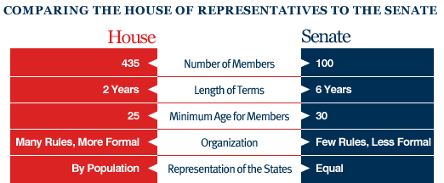
How laws get made
A law starts as a bill—an idea about a new law, written on paper. For a bill to become a federal (national) law, it has to be voted on in Congress, and then sent to the President.
If the President approves of the bill, it will be signed into law. Congress is made up of 2 Chambers: the House and the Senate.
Leading Person-Centered Care

Slide 7
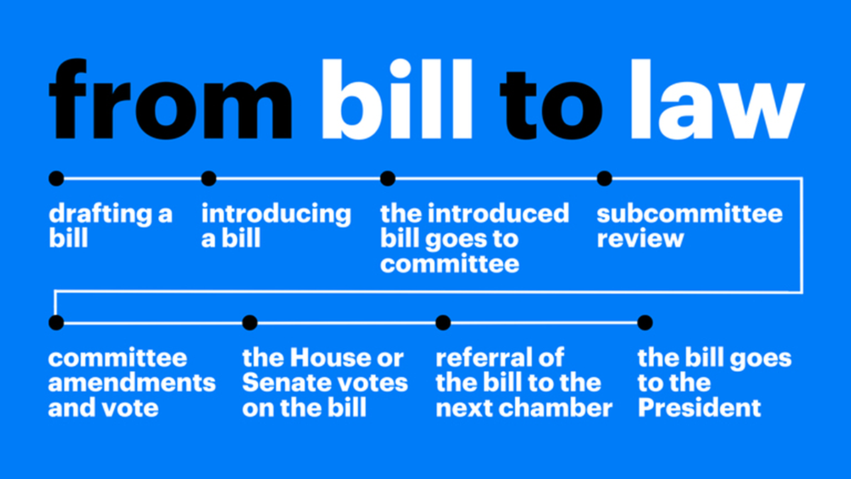
How laws get made
Leading Person-Centered Care

Slide 8
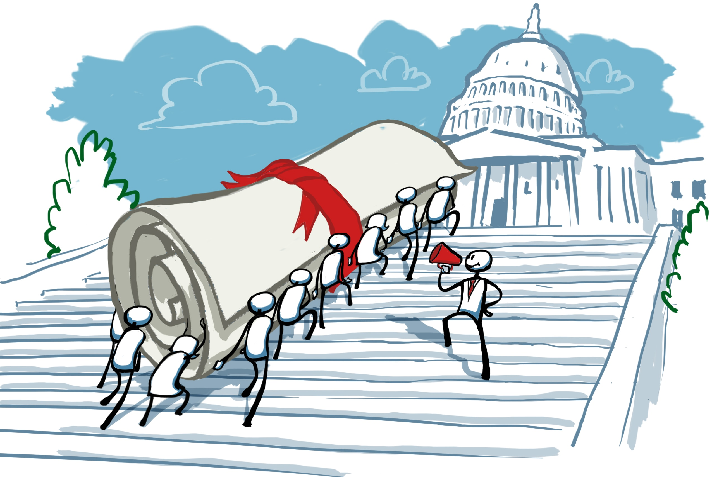
Where advocates make an impact
In a single session of Congress, 10,000 bills will be introduced. A handful will be related to hospice and palliative care. Advocates keep a lawmaker’s attention on a bill or issue (support or oppose). “This is important. I need you to do something about it.”
Leading Person-Centered Care

Slide 9
How to Be an Effective Advocate
Leading Person-Centered Care

Slide 10
How to be an Effective Advocate
Be ready to share your story
Know your role in the legislative process
Know what you are supporting and why
How do you learn about what bills are active that would impact hospice and palliative care?
Congress.gov
Media like HospiceNews
Groups like HAN
How HAN will prepare you to meet with legislators:
One-Pagers
Talking Points
Training
Leading Person-Centered Care

Slide 11
Meeting With Legislative Offices
Leading Person-Centered Care

Slide 12
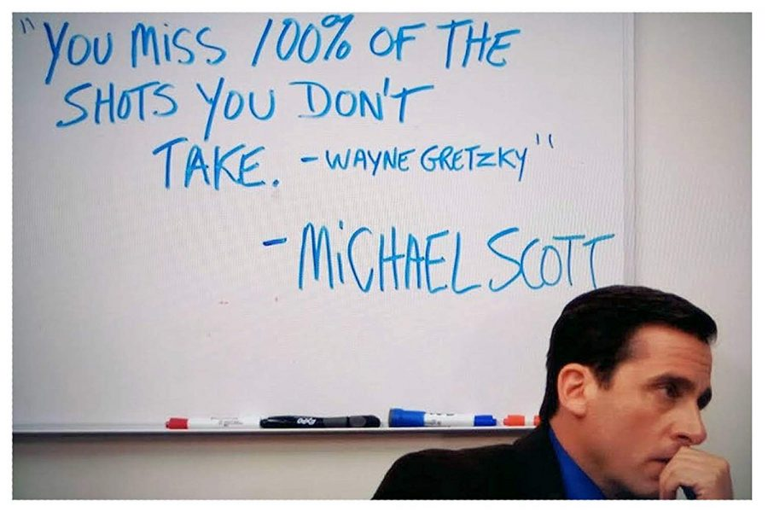
Meeting with your Legislators: It Works!
Much of advocacy work is about building relationships.
Meetings between advocates and legislative offices is one of the most effective ways to influence policy.
Your elected officials want to hear from you!
Being a part of a nonpartisan group like NHPCO / HAN is to your benefit – you are available as a resource to elected officials from anywhere on the political spectrum.

Slide 13
Goals for Meeting
Introduce Hospice
Educate about Our Issues
Build a Relationship
Gather Information
Gain Support for Our Issues

Slide 14
Meeting Structure
Introduction:
“Thank you for meeting with us. My name is Lisa Jones, and I’m a nurse with….”
The Basics:
“We are here today to tell you about hospice and palliative care in our state. Are you familiar with hospice care?” or “Have you had a personal experience with hospice care?”
The Story:
“I’d particularly like to tell you about Sarah Smith, one of my patients.”
The Asks:
“Sarah’s story is a good example of why we’d like you to support the...”
Questions or Clarifications:
Ask if they have any questions.
If they ask you something you are unsure of, just say, “I don’t know the answer to that right now, but I’m happy to look into it and get back to you.” After, let the HAN team know, and we can help you follow up.
Closing:
“Thank you for meeting with us, and thanks for your ongoing support of hospice and palliative care patients in [state].
Take a photo to post to social media (with permission!)

Slide 15
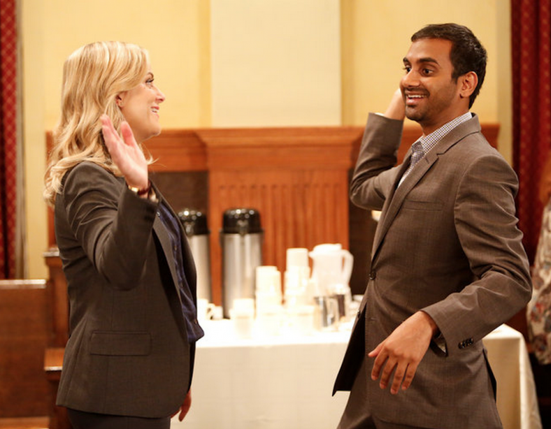
Tips for Successful Hill Meetings
Remain relaxed and flexible.
Share a hospice story that has impact that reflects a policy ask.
Try to keep your story and ask to an “elevator pitch” length (2 minutes).
Provide resources and contact information the office can use in the future.
Breathe. They’re people just like you!

Slide 16
Questions?
Leading Person-Centered Care

Slide 17
Thank You!
Stephanie Marburger Manager of Grassroots Advocacy (smarburger@nhpco.org)

